Slide 1

Project Title:
Proposal and Feasibility Presentation Template
Muhammad Awais CIIT/FA20-BSE-021/ATD
Ali Sher Khan CIIT/FA20-BSE0-078/ATD
Nabeel Javed CIIT/FA20-BSE-061/ATD
Supervisor-name
Mr. Muhammad Ali khan
Department of Computer Science
COMSATS University Islamabad, Abbottabad Campus

Slide 2
Agenda of the Presentation
Motivation
Brief Introduction
Scope
Functionalities
Proposed Tools/Platform
Feasibility
Schedule
Tasks for 1st Iteration
Conclusion

Slide 3
Motivation
E-commerce is a booming industry, and developing an e-commerce website will allow us to work on a project that has direct relevance to the current business landscape. We’ll gain hands-on experience in building a system that can be used by real customers.
Working on an e-commerce project will expose us to various technologies and tools commonly used in the industry, such as web development frameworks, content management systems, and payment gateways. We'll have the opportunity to learn and apply these technologies.

Slide 4
Brief Introduction
. Our e-commerce website is a place for the latest in technology, gadgets, and electronics. In a world driven by innovation, we're here to simplify our users tech shopping experience. Our platform is designed to make finding and purchasing the latest tech products easy and accessible. Whether our user is a tech enthusiast, a professional, or someone seeking the newest gadgets.

Slide 5
Scope
Our project is designed to cater to a wide audience, including tech enthusiasts, professionals, and everyday consumers in Pakistan. The platform will be accessible online, making it convenient for users to shop for tech products from the comfort of their homes.
Users of our system will be able to explore a diverse range of tech products, conveniently categorized for easy navigation. They can create user profiles to track their order history and personalize their shopping experience. Detailed product information, including specifications and features, will be readily available to aid users in making informed purchasing decisions. However, it's important to note that our system will not support physical retail or in-person shopping. Users will not be able to physically interact with products before purchase.

Slide 6
Scope
Additionally, the platform will focus exclusively on tech-related products, and users won't find items from other non-tech categories.
Our project aims to streamline the tech shopping experience, providing a user-centric platform that caters to the unique needs of tech enthusiasts and consumers in Pakistan.

Slide 7
Modules and its Functionalities
Module 1: User Management:
User registration and authentication.
User profiles.
Password reset and email confirmation.
Role-based access control (admin, customer, seller, etc.).
Module 2: Product Management:
Product catalog with categories and subcategories.
Product search and filtering.
Product details, images, and descriptions.
Product reviews and ratings.

Slide 8
Modules and its Functionalities
Module 3: Shopping Cart:
Add/remove products to/from the cart.
Update product quantities.
Calculate cart totals.
Save cart state for logged-in users.
Module 4: Checkout:
Shipping address and billing information.
Order summary and total.
Order confirmation.
Integration with payment gateways (Stripe, EasyPaisa, JazzCash, Master Card and Visa).

Slide 9
Modules and its Functionalities
Module 5: Order Management:
Order history for users.
Order status.
Module 6: Admin Pannel:
Product management.
User management (admin privileges).
Order management and processing.
Analytics and reporting.

Slide 10
Modules and its Functionalities
Module 7: Search and Filters:
Implement search functionality.
Allow users to filter products by various criteria (price, rating.).
Module 8: Reviews and Ratings:
Allow users to write reviews and rate products.
Display average ratings and reviews on product pages.
Module 9: Security:
Implement secure authentication and authorization.
Protect against common web application vulnerabilities.
Use HTTPS for secure data transmission.
Regularly update dependencies to patch security vulnerabilities.

Slide 11
Modules and its Functionalities
Module 10: Payment Integration:
Integrate with payment gateways like Stripe for international payments.
Integrate with local payment gateways like EasyPaisa and JazzCash for regional payments.
Module 11: Inventory Management:
Track product quantities and availability.
Automatically update product availability upon order placement.

Slide 12
Proposed Tools/Platform
Table 2Tools and Technologies for Proposed Project
Tools And Technologies | Tools | Version | Rationale
 | Visual Studio Code | 2022 | IDE
 | Mongo DB | 2022 | Database
 | Mongoose |  | Schema Validation
 | Figma | 2022 | Design Work
 | MS Word | 2019 | Documentation
 | MS Power Point | 2019 | Presentation
 | Star UML | 2.0.5 | Mockups Creation
 | Technology | Version | Rationale
 | React JS | 18 | Front End Development
 | Node JS | Es6 | Backend Development
 | Express JS | Es6 | Server
 | Socket.io |  | Notifications and chats
 | Git and GitHub |  | Version Control and Collaboration

Slide 13
Feasibility
Technical feasibility
Resources | Availability
Development Tool | Available
Programming Language | Available
Technologies | Available

Slide 14
Feasibility
Financial feasibility
Resources | Cost | Availability
Laptop | 100000 RS | Available
Mongodb | Open Source(Free) | Available
React | Open Source (Free) | Available

Slide 15
Feasibility
Resource feasibility
Working Laptop/PC are available for development
All team members has required skills to develop the system
All requires tools and platform are available
Internet connectivity is good
The project is resource feasible

Slide 16
Feasibility
Operational feasibility
The website aims to be user-friendly and accessible, ensuring that even users with basic technology skills can navigate and benefit from its features
All the required resources are already available, and project is Operationally Feasible.

Slide 17
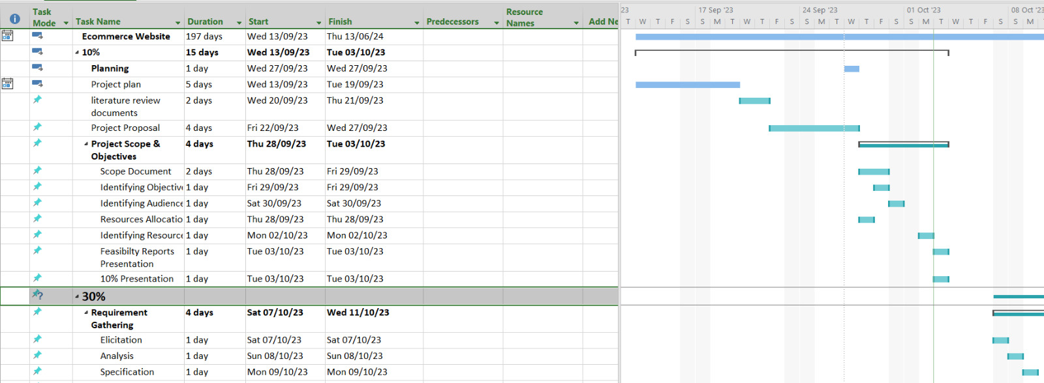
Schedule

Slide 18
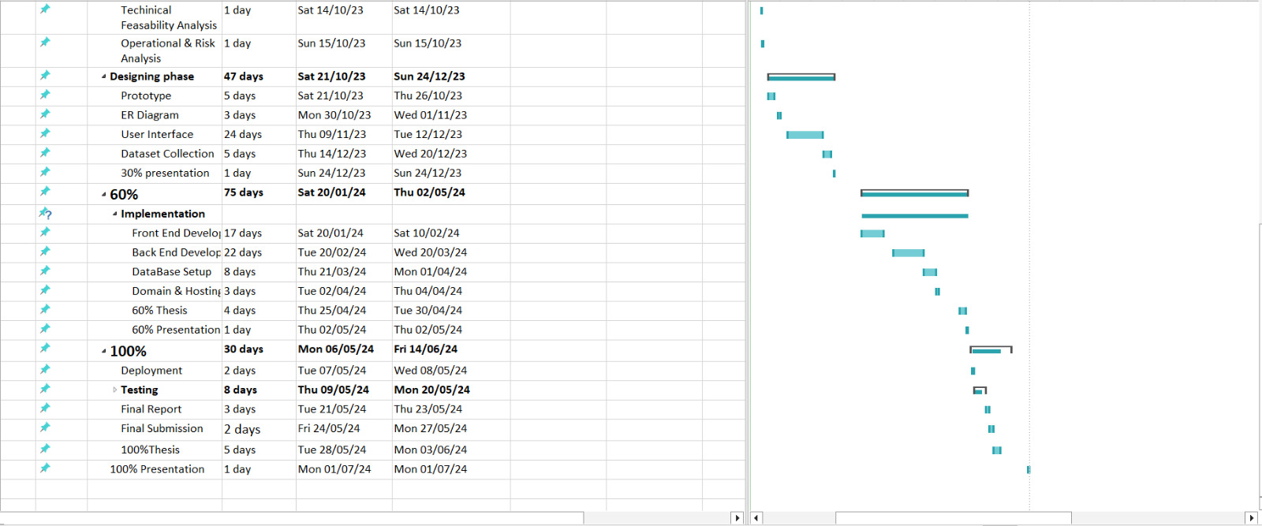
Schedule

Slide 19
Tasks for 1st Iteration (or 30%)
SRS
SDD
Minimal UI/UX Design.
UI development

Slide 20
Conclusion
In conclusion, our e-commerce project for the Pakistani tech market represents a dynamic and user-centric platform designed to meet the evolving needs of tech enthusiasts and shoppers. By integrating various data gathering techniques, responsive design principles, and key concepts like API integration and database management, we are committed to providing a seamless and secure shopping experience. Our project aims to align with industry best practices and agile methodologies to continually improve and adapt to the ever-changing tech landscape. We are enthusiastic about bringing this vision to life and delivering a valuable addition to the online tech retail ecosystem in Pakistan.

